Slide 1
Simulation & Physics
2016-2017

Slide 2
PRACTICAL 1
Motion

Slide 3
Vector2d
XNA

Slide 4
Initialize vector
Vector2 v = new Vector2(2, 5);
Vector2 w = new Vector2(-1, 3);
Vector2 position;
position = new Vector2(200, 300);

Slide 5
Add vectors
Vector2 v = new Vector2(2, 5);
Vector2 w = new Vector2(-1, 3);
v = v + w;
or
v += w;

Slide 6
Multiply a vector with a float (scale)
Vector2 v = new Vector2(2, 5);
float f = 1.7f;
v = v * f;
or
v *= f;
Does this really work?
Notes:
Ja dat werkt echt!

Slide 7
Motion
Change of position
Change of x and y coordinates
Δx
(x, y)
Δy
(x', y')
x' = x + Δx
y' = y + Δy

Slide 8
Velocity
Constant change of position
Direction of change
Magnitude of change
Vector
Vector2 position, velocity;
position += velocity;

Slide 9
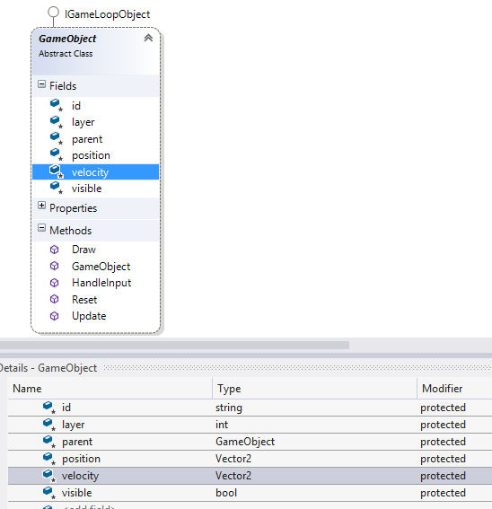
GameObject
The GameObject class has fields for a position and a velocity
The update method adds the velocity to the position

Slide 10
Practical 1
Download the instructions and the XNA solution for practical 1 from the VLO;
Start with assignment 1 and 2
Drawing balls
Movement
(XNA in Visual Studio 2017: https://gist.github.com/roy-t/2f089414078bf7218350e8c847951255 )

Slide 11
Bouncing
Boundaries, gravity, acceleration and friction

Slide 12
Boundaries
Moving off the stage?
Set boundaries
Keep object within boundaries
GameEnvironment.Screen
Notes:
Via GameEnvironment.Screen kom je bij de dimensies van het scherm

Slide 13
position before bounce
(p.x + radius, p.y)
direction after bounce
boundary

Slide 14
position before bounce
Simple solution (“cheating”)
Creating the illusion
of a real bounce
position before correction
position after correction
direction after bounce
boundary

Slide 15
Practical 1
Make assignment 3
Bouncing balls

Slide 16
Gravity
Constant change of velocity
Magnitude of change
float gravity = 0.1f;
velocity.Y += gravity;
Could the gravity also be a vector?
Notes:
Gravity zou ook een vector kunnen zijn inderdaad

Slide 17
Acceleration
Constant change of velocity
Direction of change
Magnitude of change
Vector
v = v + a
Vector2 acceleration = new Vector2(0, 10);
velocity += acceleration;

Slide 18
Friction
Drag, resistance, damping
Changes magnitude of velocity
Easy and cheap solution: taking a fraction of the magnitude
float friction = 0.99f;
velocity *= friction;

Slide 19
Inelastic bounce
Loss of energy
Loss of velocity
Bounce with “friction”
Apply friction only when the ball bounces

Slide 20
Practical 1
Finish the rest of the assignments
Gravity
Acceleration
Friction
Hand in your report via VLO group assignments
before May 7th, 23:00

